Slide 1
Requirement Analysis
Implementation of a Mobile Based Disaster Management System
Analysis
Course: Internet and Mobile Programming
Course Instructor: Dr. NKEMENI VALERY
Group 7

Slide 2
A phase of the software development life cycle (SDLC), where you define and document the needs and expectations of your clients and users.
It involves gathering, analyzing, validating, and managing the requirements that will shape the scope and quality of your software project
Requirement Analysis
Specify requirements at a level that allows developers to develop systems according to stakeholder needs.
Developers need detailed level requirements to construct solutions. Poor requirements analysis can result in large number of requirement changes!
Definition and Purpose

Slide 3
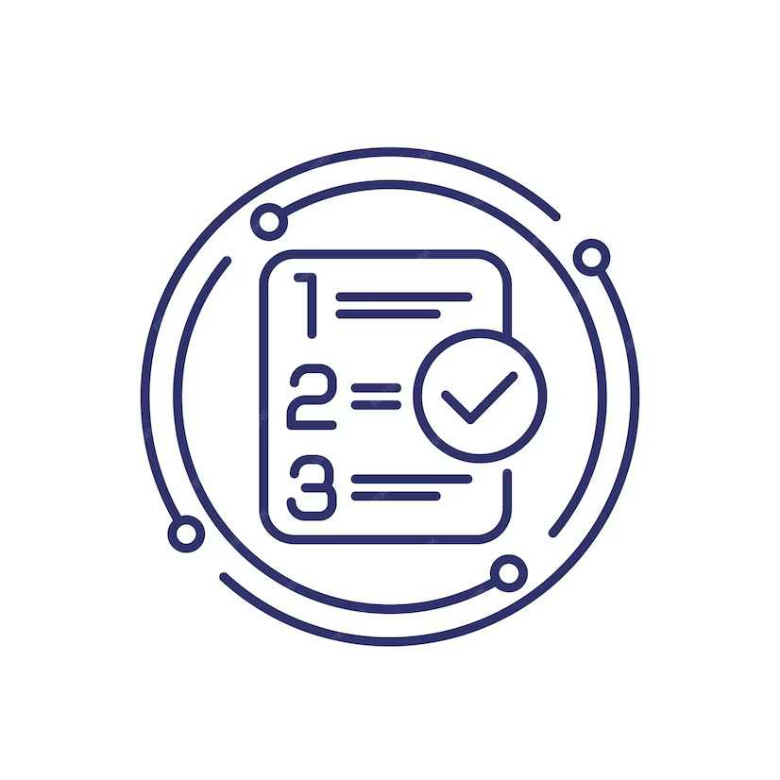
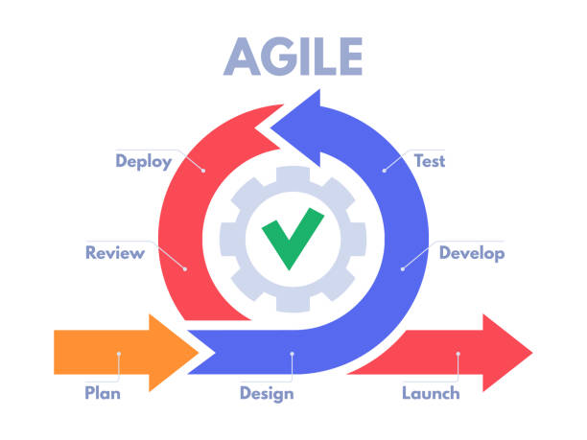
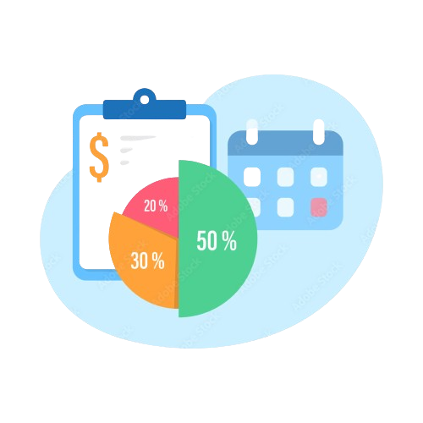
System Requirements
Analysis and Prioritization
Development Model
Assumptions & Constraints
Functional
Non-Functional
Data
Technical
Operational

Slide 4
Categorization of Requirements
Facilitate detecting problems like conflicts and overlaps
Finding requirements that are similar and can be combined (duplicates)
Why Considering Doing This?

Slide 5



Functional Requirements
Real-time Alert
Push notifications about disasters happening and after news.
Geospatial Data integration
Live location services, to show routes for easy escape.
MORE
-First-Aid Tools section
-Community Engagement
-Language Preferences
Specific features and functions of the system from users’ point of view after analysis
Incident Report and assistance
Ability to report disasters and request assistance

Slide 6
Non-Functional Requirements
PERFORMANCE
RELIABILITY
USABILITY
SECURITY
Focus on the quality attributes of the system, ensuring it performs effectively under various conditions
COMPLIANCE

Slide 7
Data Requirements
Disaster Information
Meteorological data, geological surveys, emergency reports.
Government websites, social media, public broadcasting systems.
Public Information and Alerts
Geospatial Data
GIS databases, satellite imagery providers,drones.
Accurate, timely, and comprehensive data needed to effectively manage disaster response and recovery efforts.
Incident reports
Field reports, emergency call centers.

Slide 8



Technical Requirements
Network Infrastructure
Architectural Frameworks
Cloud-Based servers

Slide 9

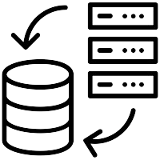

Operational Requirements
Disaster Recovery
Data Backup
Real-Time Monitoring

Slide 10
Prioritized Requirements
Evaluation and Ranking

Slide 11
Key Factors to Consider in Prioritization
1
2
3
4
User Needs
Human Values
Feasibility
Risks
What exactly the user needed from our requirements.
Does each requirement align with human values and ethics?
Ease of development of proposed features and functionalities.
The various issues and risks that come with developing a functionality.

Slide 12
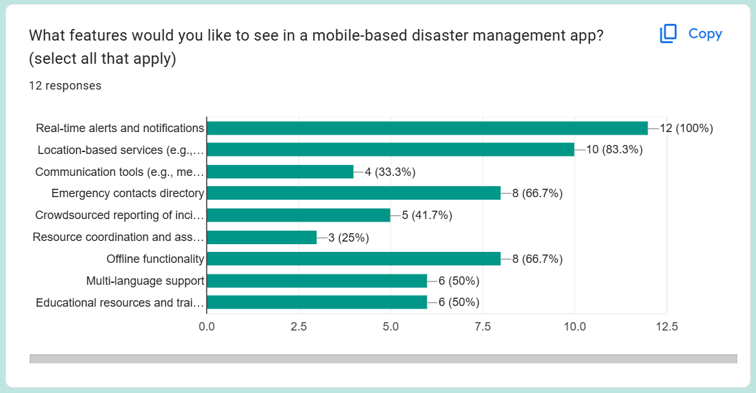
Analysis of features according to user preferences

Slide 13
Prioritizing functionalities
90 - 100%
70 - 90%
50 - 70%
50% & below
Real-time alerts and notifications
Location-based services
Emergency contacts
Offline functionality
Multi-language functionality.
Educational resources for sensitization
Communication tools for messaging
Reporting incidents
Resource coordination

Slide 14
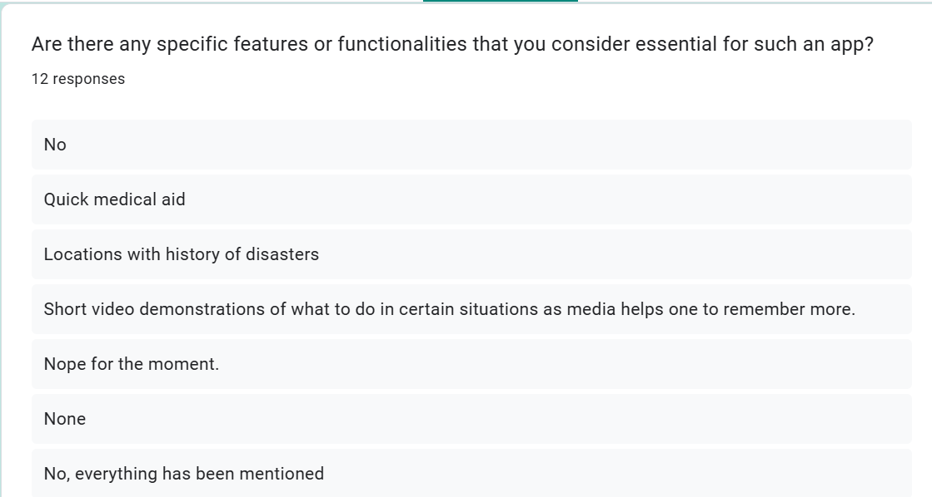
Proposals given by our users

Slide 15
Quick Medical Aid from Emergency Units
DIYs videos in Emergency situations
History of Hazardous Areas
Fast Response to their needs

Slide 16
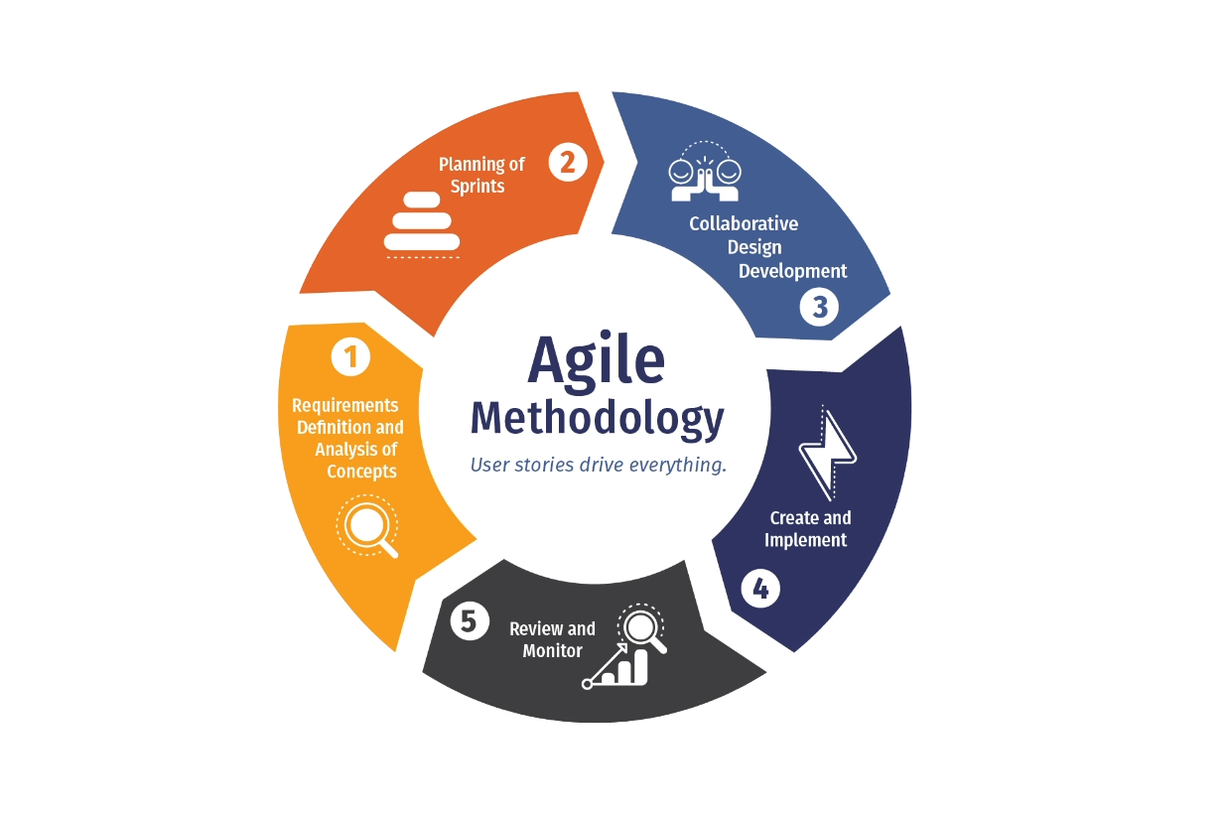
Development Model
What is it ?
Iteration
Delivery
Emphasizes and iterative development approach
Rapid delivery of functional product increments
Flexible
Collaboration
Provide flexible responses to changes
Solutions evolve through collaboration between team

Slide 17
Why ?
Flexibility and Adaptability
Unpredictable disasters,
Change in requirements
Enhancement of application
Allows for changes to be made easily at any point in the development cycle
Regular reflection ensuring the application evolves with the needs of users.
Stakeholder Engagement
Continuous Improvement
Risk Management
Close collaboration with various stakeholders
Technological and requirement changes
Ensure stakeholders input is continuously integrated
Mitigate risks by delivering small, functional parts of the application early and frequently, allowing detection of issues.

Slide 18
Assumptions & Constraints
When we plan anything, from building a house to developing an app, we make assumptions and encounter constraints.

Slide 19
Assumptions
Basic Literacy
Smartphone Compatibility
Target population has base level of literacy
Users will use either Android or iOS environments
Some Level of Connectivity
Community Awareness
Some level of cellular or WiFi will be available even if disrupted during a disaster
General public interest in disaster preparedness

Slide 20
Constraints
T
C
D
U
Battery life, processing power, storage.
System should work with limited or no internet
Updates, security, ensuring compatibility
Lack of awareness, limited literacy
Technological Limitations
Connectivity Issues
Cost & Development
User Adoption & Training
Mobile devices have limitations
Disasters can disrupt communication networks
Developing and maintaining a robust app can be expensive
Encouraging the use of the app within the community

Slide 21
Conclusion
A mobile disaster management app is not just a piece of software; it is a potential lifeline. By investing in a comprehensive requirements analysis, we can ensure this app becomes a powerful tool for saving lives, minimizing damage, and fostering resilience within communities most vulnerable to disasters.

